Slide 1
How to participate in Federal Advocacy at LWV
May 6, 2021
LWV Oregon state convention

Slide 2
Welcome
Thank you for attending!
Priya Pandey (she/hers)
Legislative and Policy Coordinator
kpandey@lwv.org
Notes:
Autumn:​
Just a reminder on some practical items:​
​
Lines are muted in order to prevent background noise. Our chat is open throughout the session and staff is monitoring it. We will answer as many questions as possible during the session and follow up as needed. ​
​
As another reminder we record these meetings (that includes the chat) and will be sharing the link and other follow up items post webinar. ​
​
I will now turn the microphone over to Dr. Turner

Slide 3
Agenda
What is Federal Advocacy?
LWVUS National Priorities
Working Together to Influence Public Policy
Advocacy vs Lobbying
DEI Lens
LWVUS Work On The Hill
LWVUS Work With Coalitions
Advocacy at the National Level

Slide 4
What is Federal Advocacy?

Slide 5
Congressional Priorities for LWVUS
HR1/S1 For the People Act.
The John Lewis Voting Rights Advancement Act
HR 51 Statehood for D.C.
ERA Ratification
Campaign Finance Reform
Election Security Bills
Immigration Reform (DREAM Act)
Climate Change (RECLAIM ACT)

Slide 6
What is Federal Advocacy
Building public support around an issue area
Education around issues that require federal advocacy
Talking to Members of Congress about a topic
Engaging with grassroots folks on a topic/issue
Grow interest, engagement and understanding on a topic/issue

Slide 7
Advocacy Vs Lobbying
Advocacy is a broader concept; considered to be more "educational"
Developing public policy briefs that analyze and issue and provide recommendations
Providing forums for discussion and educating policymakers and the public
Understanding the overall cause
Lobbying is defined as an attempt to influence specific legislation
Communicating a specific point of view on a bill
Urging public to contact their legislators about a specific bill
Sharing with the general public a view point about referendum or ballot measures

Slide 8
Future of Congress and LWV Priorities
Program Items:
The LWVUS Board recommends a League-wide Campaign for Making Democracy Work®: Voting Rights, Improving Elections, Campaign Finance/Money in Politics, and Redistricting
The LWVUS Board also proposes continuing work on urgent issues: Climate Change, the Equal Rights Amendment, Health Care, Gun Safety, and Immigration.
Finally, the LWVUS Board recommends that the Electoral Systems Concurrence

Slide 9
Working Together to Influence Public Policy
Speaking With One Voice
League Lobbying
Taskforces and Committees
Coalition based work
Grassroots and relational organizing

Slide 10
Applying a DEI Lens to Our Work
All work is examined in this lens to ensure equity and inclusivity in our work.
Questions to consider:
Who is involved?
Who will be impacted?
What are the intended and unintended outcomes?
Does this align with our vision for an equitable and inclusive organization?
What changes can be made to make this more equitable?

Slide 11
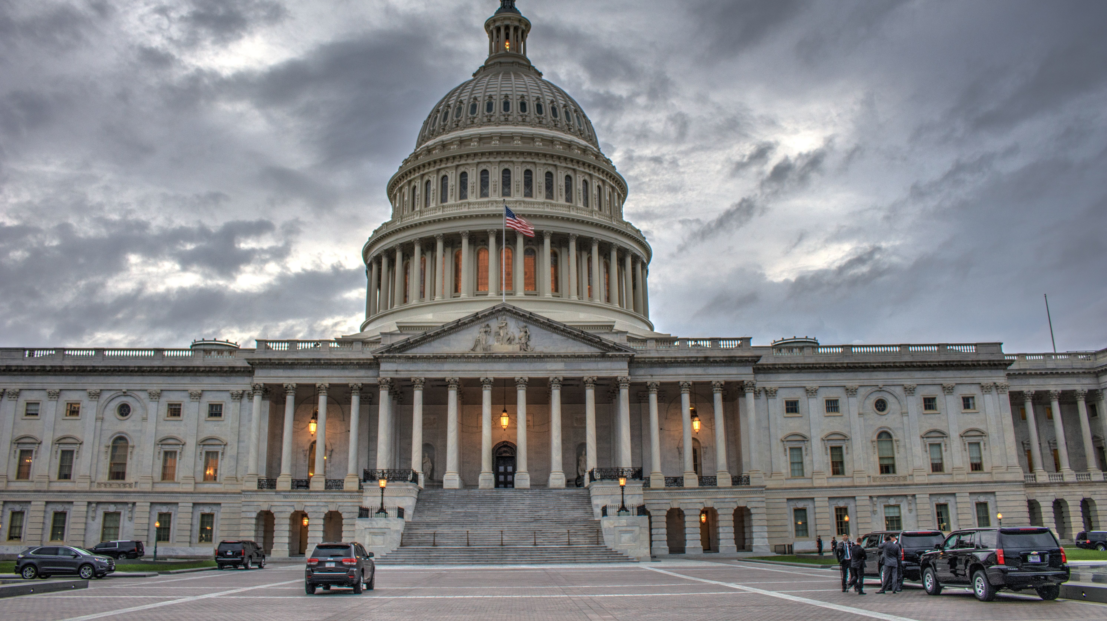
LWVUS Work on The Hill

Slide 12
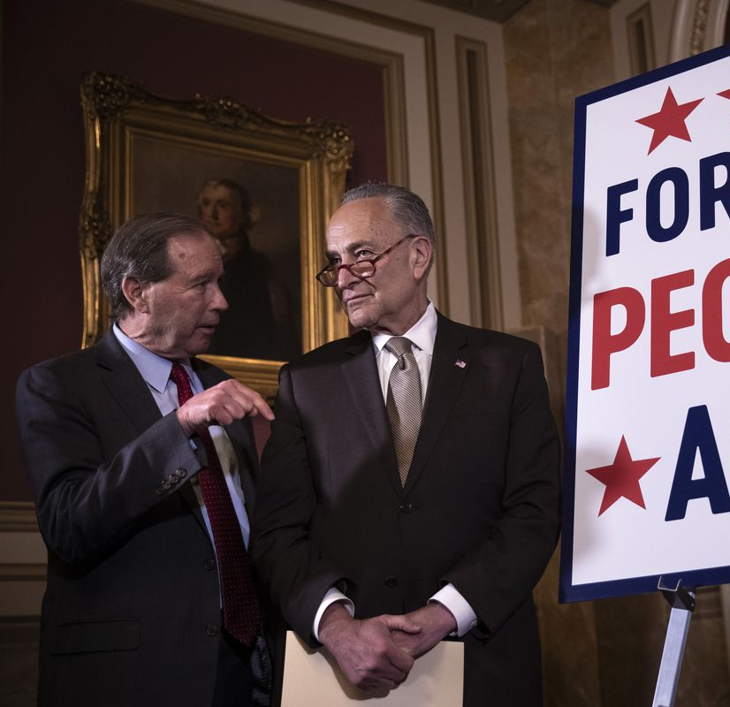
The For The People Act
Originally introduced in 116th Congress
LWVUS helped write and recommend same day voter registration language
Major progress in 117th Congress
LWVUS works with Declaration For American Democracy
Strategy:
Hill Meetings: 86
Grassroots Organizing
Rapid Response
Testimony

Slide 13
John Lewis Voting Rights Advancement Act
Introduced in 116th Congress
Renamed as John Lewis VRAA in honor of Rep. Lewis
LWVUS CEO Virginia Kase testified in front of House Judiciary Committee on the bill
Has not been reintroduced
LWVUS works with Leadership Conference on Civil and Human Rights
Strategy:
Testimony training and storytelling
Grassroots lobbying
Hill meetings

Slide 14
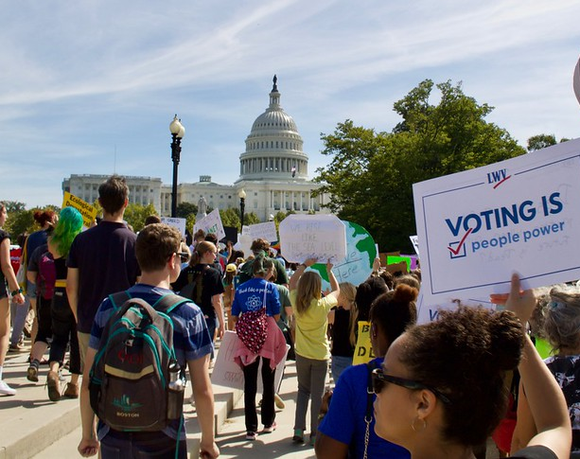
Other League Issues
D.C. Statehood: Passed in House waiting on Senate introduction. LWVUS will be engaging with Senate members.
ERA Ratification: Sending memos to hill. Looking for opportunities to testify and engage Leagues.
DREAM Act and Immigration: Wrote letter of support to the hill. Signed letter addressing Biden Adminstration asking for them to support comprehensive immigration reform.
Gun Violence: Active Action alert you can use to contact your Member of congress.
We continue to watch Congress closely to see where we can best plug in

Slide 15
Advocacy at the National Level
LWVUS Advocacy and Litigation Team
Action Alerts
LWVUS Lobby Corps
Grassroots Lobbying

Slide 16
Grassroots Lobbying and Advocacy Opportunities
Train the trainer events
Hill Meeting invitations
Letters to Members of Congress
In District Lobbying Visits
LWVUS Staff will reach out to State leadership to coordinate this
League Update has announcements as well

Slide 17
Federal Action Request Form
Any state or local League wishing to act on an issue at the national level that is not a priority of the national board must use this form to do so.
State League President should be consulted and looped in by local League as they are submitting the form
LWVUS has developed an online form that goes directly to advocacy team for review.
LWVUS Staff will review request and respond with feedback or approval.

Slide 18
Action Alerts and Call In Days
Take Action Page: lwv.org/takeaction
Action Alerts that go directly to congress on certain issues
Check your inbox for emails
Check the League Update for active action alerts
Taking Action page will let you know what is currently happening in Congress right now
You can also see LWVUS progress and comments on federal legislation
This Photo by Unknown author is licensed under CC BY-SA.

Slide 19
Resources
Taking Action Page
Federal Advocacy Request Form
Impact on Issues
Monthly Policy Webinars
LWVUS Blogposts
League Update
This Photo by Unknown author is licensed under CC BY-SA.

Slide 20
Additional Questions: Contact us advocacy@lwv.org

