Slide 1
Concurrence on Forestry Positions Adopted by Washington LWV
2021 Convention May 11, 20021

Slide 2
Need for Concurrence on Forestry Issues: Similar History, Tree Species and Timber Ownership
Washington
Oregon
Half of Washington is forested:
43 million acres total
22 million acres is forested evenly divided between east and west of the Cascade Crest.
Forestland: 52% private, 48% public
9.2 million acres private
18 million timberland
Half of Oregon is forested:
61-million-acres of land area
30 million acres is forested evenly divided between the east and west side of the Cascade Crest.
34% Private, 64% public
9.4 million acres private
24 million acres is timberland

Slide 3
Similar History: Land Grants and Railroad Land Ceded to Counties for Schools, Managed by State Forestry Agency
Washington
Oregon
Washington Territory 1853
Statehood: 1889 federal land grants: Common School trust with about 1.8 million acres of forestland and other properties for school construction
Railroad land sold to private timber companies
During depression years (1920s 1930s) private land donated to counties and USFS as state Trust Lands to avoid taxes after harvest
Later given to the state to be managed by the Dept of Natural Resources (DNR)
Oregon Territory 1848
Statehood: 1859: 3.4 million acres of the new state’s land "for the use of schools."
Railroad land sold to private timber companies
During depression years, private land was donated to counties and USFS for unpaid property taxes
Donated county lands become trust lands to be managed by state (ODF) but revenue from timber sales goes back to counties for schools, etc.

Slide 4
Legislative and Forest Governance Differences
Washington
Oregon
Legislature
Economy*
Forestry Agency (DNA)
Agency Funding
Timber and other taxes
Enforcement vs. cooperative approach
Predictability Consistency for long term planning (HCP)
Legislature
Economy: Timber Influence
Forestry Agency (ODF)
Agency Funding
Timber and other taxes
Enforcement vs. cooperative approach
Predictability Consistency for long term planning (HCP)
*Washington is the 4th largest exporting state in the country
Forest products are the second highest export in the state after aircraft and
above High Tech (in 1999)
-

Slide 5
What Prompted the Study?
Awareness of the critical importance of forests both regionally and globally at maintaining healthy environment
Strong positions for various environmental issues but none about forestry
horrified by some of the logging practices that failed to protect creeks, soil erosion, etc.
Need to support advocacy with sound factual information
Research needed:
a. history of our forests
b. tribal lands
c. current practices
d. forest policies
e. federal and state laws re: forests and land use
f. State Trust Lands

Slide 6
Focus of Washington’s 4-year Studies
Washington Position Needed
Oregon Positions Needed
Inadequate Laws
Compliance, Enforcement and Funding of State Programs
Accurate Data
Conversion of land from Forest to Non-forest Use
Roads
Land Trades
Trust Lands and the Pressure to Provide School funding
Forest Fire Suppression Policy
Climate and Carbon Sequestration Issues
Inadequate Harvest Practices Laws: stream buffers, drinking water and soil protection – Measure 49
Compliance, Enforcement and Funding of State Programs
Accurate Data
Conversion of land from Forest to Non-forest Use
Roads
Trust Lands and the Pressure to Provide School Funding
Forest Fire Suppression Policy
Climate and Carbon Sequestration Issues
Adequacy of timber taxes: TIMOs and REITs and corporate taxes to match Washington’s

Slide 7
Washington’s Study Committees
1st study in 1998: 15 members; 2nd study in 2000: 11 members
In-person meeting at least twice a month in Olympia, sometimes weekly
Communicated via email and telephone
Various members focused on one or two major issues and wrote up their portion
Editor wrote it all so it would read as one voice!!!
Interviewed many agencies and individuals to gather the information
Tours of many sites some on land and some via plane

Slide 8
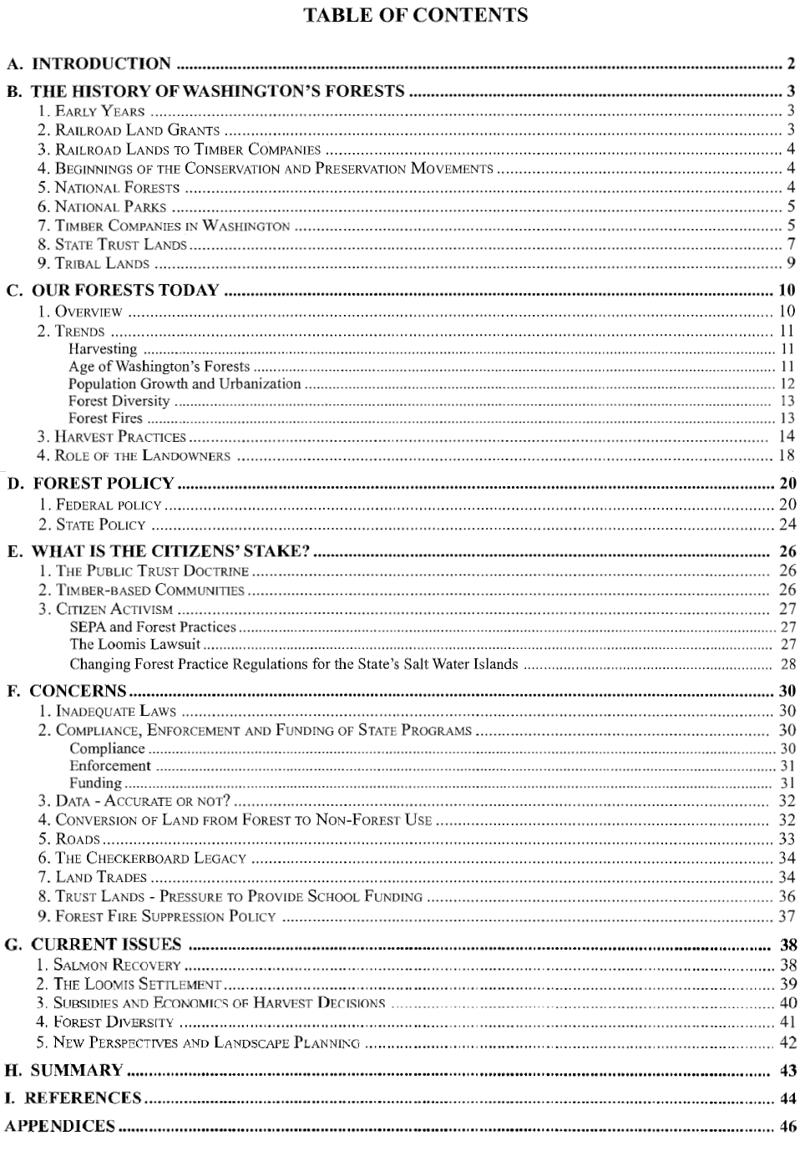

Slide 9
Why a Second Study?
Issues that not covered in first study:
Economics of forests\implication on the global economy
World Trade and Forest issues
Establishment of the World Trade Organization and affect on forestry
Management and sale of public land--both federal and state
Ongoing pressure on federally granted state lands to cut timber for revenue to support education (population increases but number of trees does not)
Ongoing issues with use of public lands: for whose benefit?

Slide 10
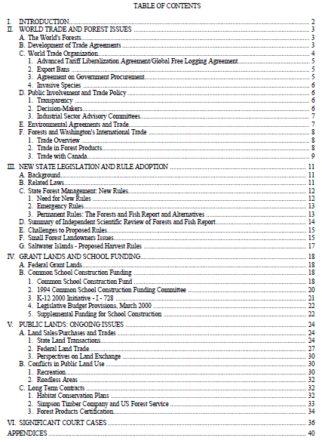

Slide 11
Best Practices from Studies and Oregon LWV Research
Lewis McCord military base near Tacoma owns some of the best sustainable forest in the state, along with Shepherd Tree Farm and Yakima Indian Nation.
Lewis McCord does some logging but they also follow all the best practices including removal of weaker trees and leaving healthy older ones. (Standing board footage has doubled and is more profitable in the process)
Consider whole watersheds and in analysis (Watershed Administrative Units)
Maintain large diameter trees
Use selective harvesting or patch harvesting leaving seed trees rather than clear-cutting with feller-bunchers
Minimize heavy equipment and logging roads
Maintain long-term ecosystem productivity and function
Consider all values of the forest during all levels of the decision-making process. Although the Yakama Nation depends on the forest for most of its annual income, management decisions will not be based on monetary values alone
Maintain a natural appearance in the forest

Slide 12
Position Statements
Based on Washington’s Dymanic Forests studies (1999, 2001)
The League of Women Voters of OREGON finds:
FO-1: That all benefits of the forests—ecological, human and economic—are inextricably interconnected. Healthy forests are essential to habitat for a diversity of plant and animal life, to the hydrologic cycle, and to carbon storage to mitigate global warming. In addition, healthy forests are essential to a forest products industry with the jobs and goods they provide, and to the economic and aesthetic values of their recreational opportunities. Therefore, The League of Women Voters of Oregon supports:
FO-2: Laws and policies to insure that forest management (for timber extraction, recreation or any other activity) is carried out in a manner that will sustain healthy forests, streams and habitats. The League of Women Voters of Oregon believes that the following are essential elements of an adequate forest practices policy:

Slide 13
Position Statements
FO-3: The public must be informed and involved in the decision-making process in the development of regulations. There must be adequate public notice of forest practices permit applications, hearings, meetings and proposed actions. Public review and comment at each phase of policy and regulation development should be required. Citizens and stakeholders must be represented on the decision-making bodies.
FO-4: There must be authority and funding for enforcement of regulations. Existing land use and forest practices regulations must be monitored and enforced, and should be responsive to changing scientific knowledge. There must be coordination of regulations for public and private lands among governmental entities.
FO-5: Riparian zones are an integral part of the forest ecosystem and must be regulated adequately to protect the streams and the wildlife dependent upon the streams.

Slide 14
Position Statements
FO-5: Education should be made available to timber owners on scientifically sound forest practices with the establishment of a small landowners’ agency for this purpose.
FO-6: Environmental values of the lands proposed for trade must be considered before the economic values. Trained appraisers, with public oversight, must be used. The right of appeal must be available to the public.
FO-7: Full accounting of all costs, including cumulative ecological impacts, of timber harvests and other forest uses must be considered in forest activity decisions.

Slide 15
Position Statements
FO-8: Forest management must be responsive to scientific research and knowledge and should include:
mapping, classification and protection of all streams,
more and better data—including total watershed analysis,
evaluation of cumulative effects of various activities in the forest in the consideration of individual forest practice permits, and
planning for sustainability of forest ecosystems.
FO-9: The State should consider ecological protections the most important factor in deciding which activities to allow on state forest lands.
FO-10: Motorized activities should be restricted and in separate areas from non-motorized activities

Slide 16
Position Statements
FO-11: Forest roads must be built, maintained and decommissioned to have the least impact on the forest ecosystems. Some areas on state lands should be roadless.
FO-12: Educate consumers about the human and ecological values of our forests as well as the opportunities and benefits of more efficient use of forest products, recycling and the use of alternatives to wood.
FO-13: Fund independent scientific research that would include improved forest practices and ecologically sound alternatives to the use of wood.

Slide 17
Position Statements
FO-14: Tax benefits and compensation should be considered to encourage small landowners to manage their forests in an ecologically sustainable manner.
FO-15: Oregon schools must be fully funded with less reliance on timber harvests.
FO-16: Trust lands should remain in public ownership.

Slide 18
Questions and Discussion
Next steps

